Slide 1

Phishing awareness

Slide 2
CONTENT
What is Phishing?
Importance of phishing awareness
Types of phishing
Common phishing techniques
Best ways to avoid phishing
Conclusion

Slide 3
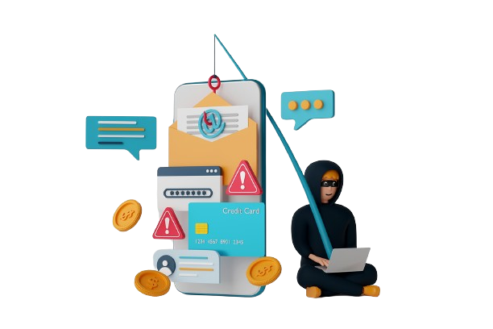
What is phishing?
Phishing is a type of cyber attack where criminals impersonate trustworthy entities, such as banks or reputable companies, to deceive individuals into divulging sensitive information like passwords, credit card numbers, or personal identification details. These attacks often occur through fake emails, websites, or even phone calls and text messages that appear legitimate, with the aim of stealing the victim's data for fraudulent purposes. Recognizing and avoiding these deceptive tactics is crucial to protecting personal and financial information.

Slide 4
Importance of fishing awareness
Protects Sensitive Information
Safeguards Organizations
Reduces Cybersecurity Incidents
Promotes Vigilance
Supports Legal and Regulatory Compliance

Slide 5
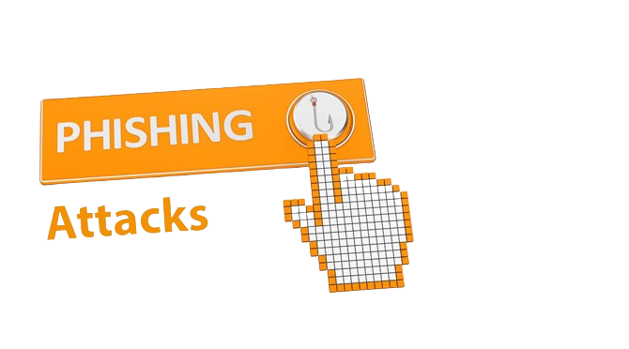
Types of Phishing
Email Phishing
Spear Phishing
Whaling
Vishing (Voice Phishing)
Smishing (SMS Phishing)

Slide 6
Common phishing techniques
Deceptive Emails: Fraudulent emails that look like they come from legitimate sources, asking for personal information or clicking on malicious links.
Clone Phishing: A legitimate email is copied and altered with malicious links or attachments, then resent to the victim.
Link Manipulation: URLs are slightly altered to resemble real websites, tricking users into visiting fake sites.

Slide 7
Common phishing techniques
Fake Websites: Websites designed to mimic legitimate sites, where users are deceived into entering sensitive information.
Spoofing: The sender's address is faked to make an email appear as though it comes from a trusted source.

Slide 8
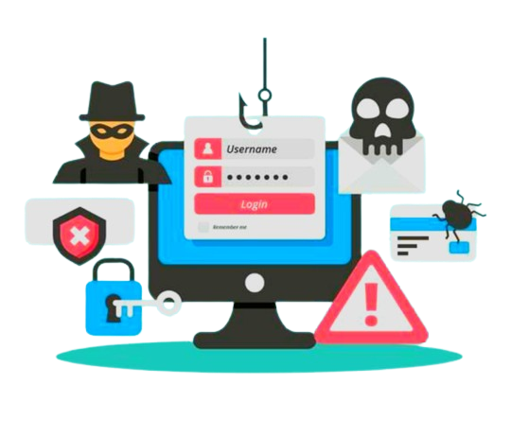
Best ways to avoid phishing
Be Cautious with Unsolicited Emails : Don't open emails from unknown senders, especially if they contain attachments or links.
Verify the Source: Always double-check the sender's email address and website URLs for any signs of manipulation or misspelling.
Avoid Clicking on Suspicious Links: Hover over links to see where they lead before clicking, and avoid clicking on links in unexpected or unsolicited messages.
Enable Multi-Factor Authentication (MFA) : Use MFA to add an extra layer of security, making it harder for attackers to access your accounts even if they obtain your credentials.

Slide 9
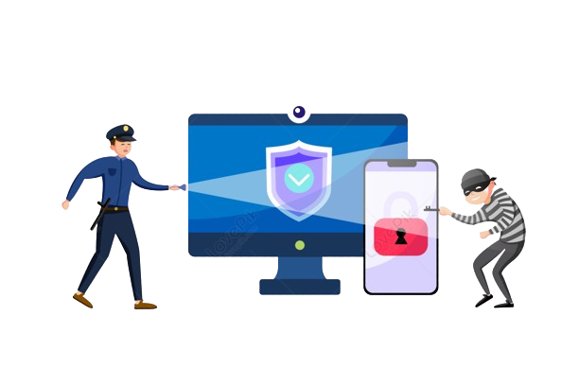
Conclusion
Phishing attacks are a significant threat in today's digital world, but by staying informed and vigilant, you can protect yourself and your organization from these deceptive tactics. Always be cautious with unsolicited communications, verify the authenticity of requests for personal information, and use strong security practices like multi-factor authentication. By recognizing the signs of phishing and following best practices, you can help create a safer online environment for everyone. Remember, awareness is your best defense against phishing. Stay alert, stay secure.

Slide 10
Thank you
Kuranage Nishama Apsara Perera
Student ID : CA/JL3/14687

